Slide 1

DEPARTMENT OF COMPUTER SCIENCE
COLLEGE OF BASIC SCIENCE & HUMANITIES, OUAT
Guide Teacher: Mrs. Binita Dash

Slide 2
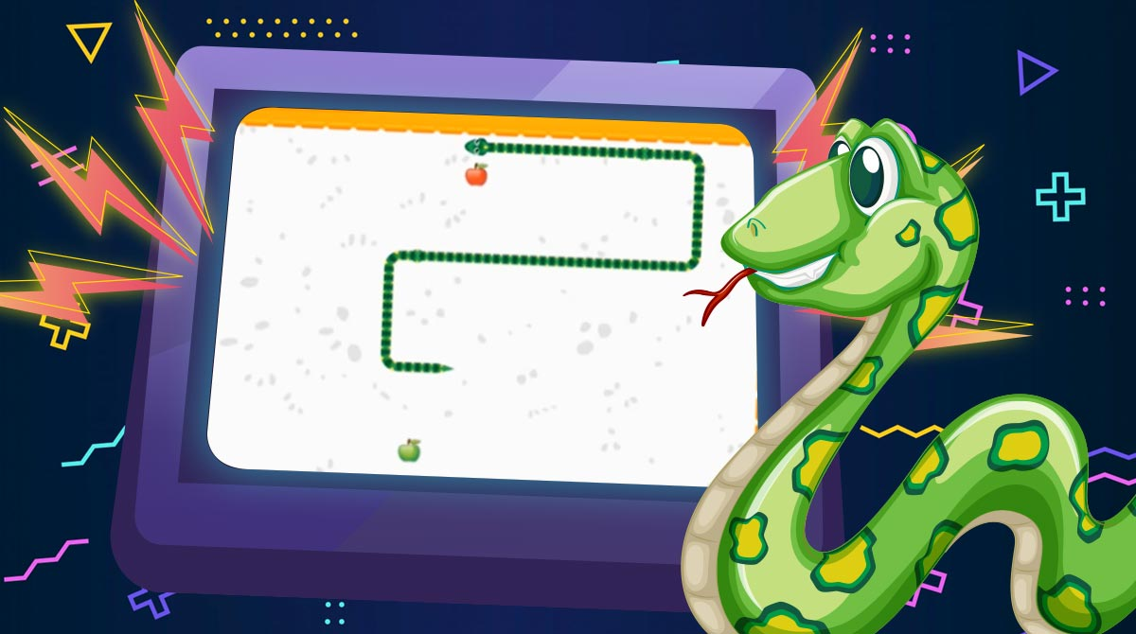
Hungry Snake RE-Live Your Childhood!!

Slide 3
CONTENTS
INTRODUCTION
HISTORY
WHY THIS GAME?
TECHNOLOGY AND SOFTWARE USED
GAME LOGIC
SOURCE CODE AND GAMEPLAY
CONCLUSION

Slide 4
INTRODUCTION

Slide 5

Hungry Snake game is one of the most popular arcade games of all time. In this game, the main objective of the player is to catch the maximum number of prey without hitting the wall or itself.

Slide 6
HISTORY

Slide 7
Snake game first appeared on a Nokia device in 1997 on the Nokia 6110. Taneli Armanto, a Design Engineer adapted it for Nokia devices. Snake was one of three games introduced in 1997, the others were Logic and Memory.

Slide 8

WHY THIS GAME?

Slide 9
1.
2.
3.
The Project is easy to develop and accessible to others.
We are new to this field.
Growing E-sports in India.

Slide 10
TECHNOLOGY AND SOFTWARES USED

Slide 11


SOFTWARE USED
PYTHON
VSCODE

Slide 12
LIBRARY USED
PYGAME
Auto
PY to EXE

Slide 13
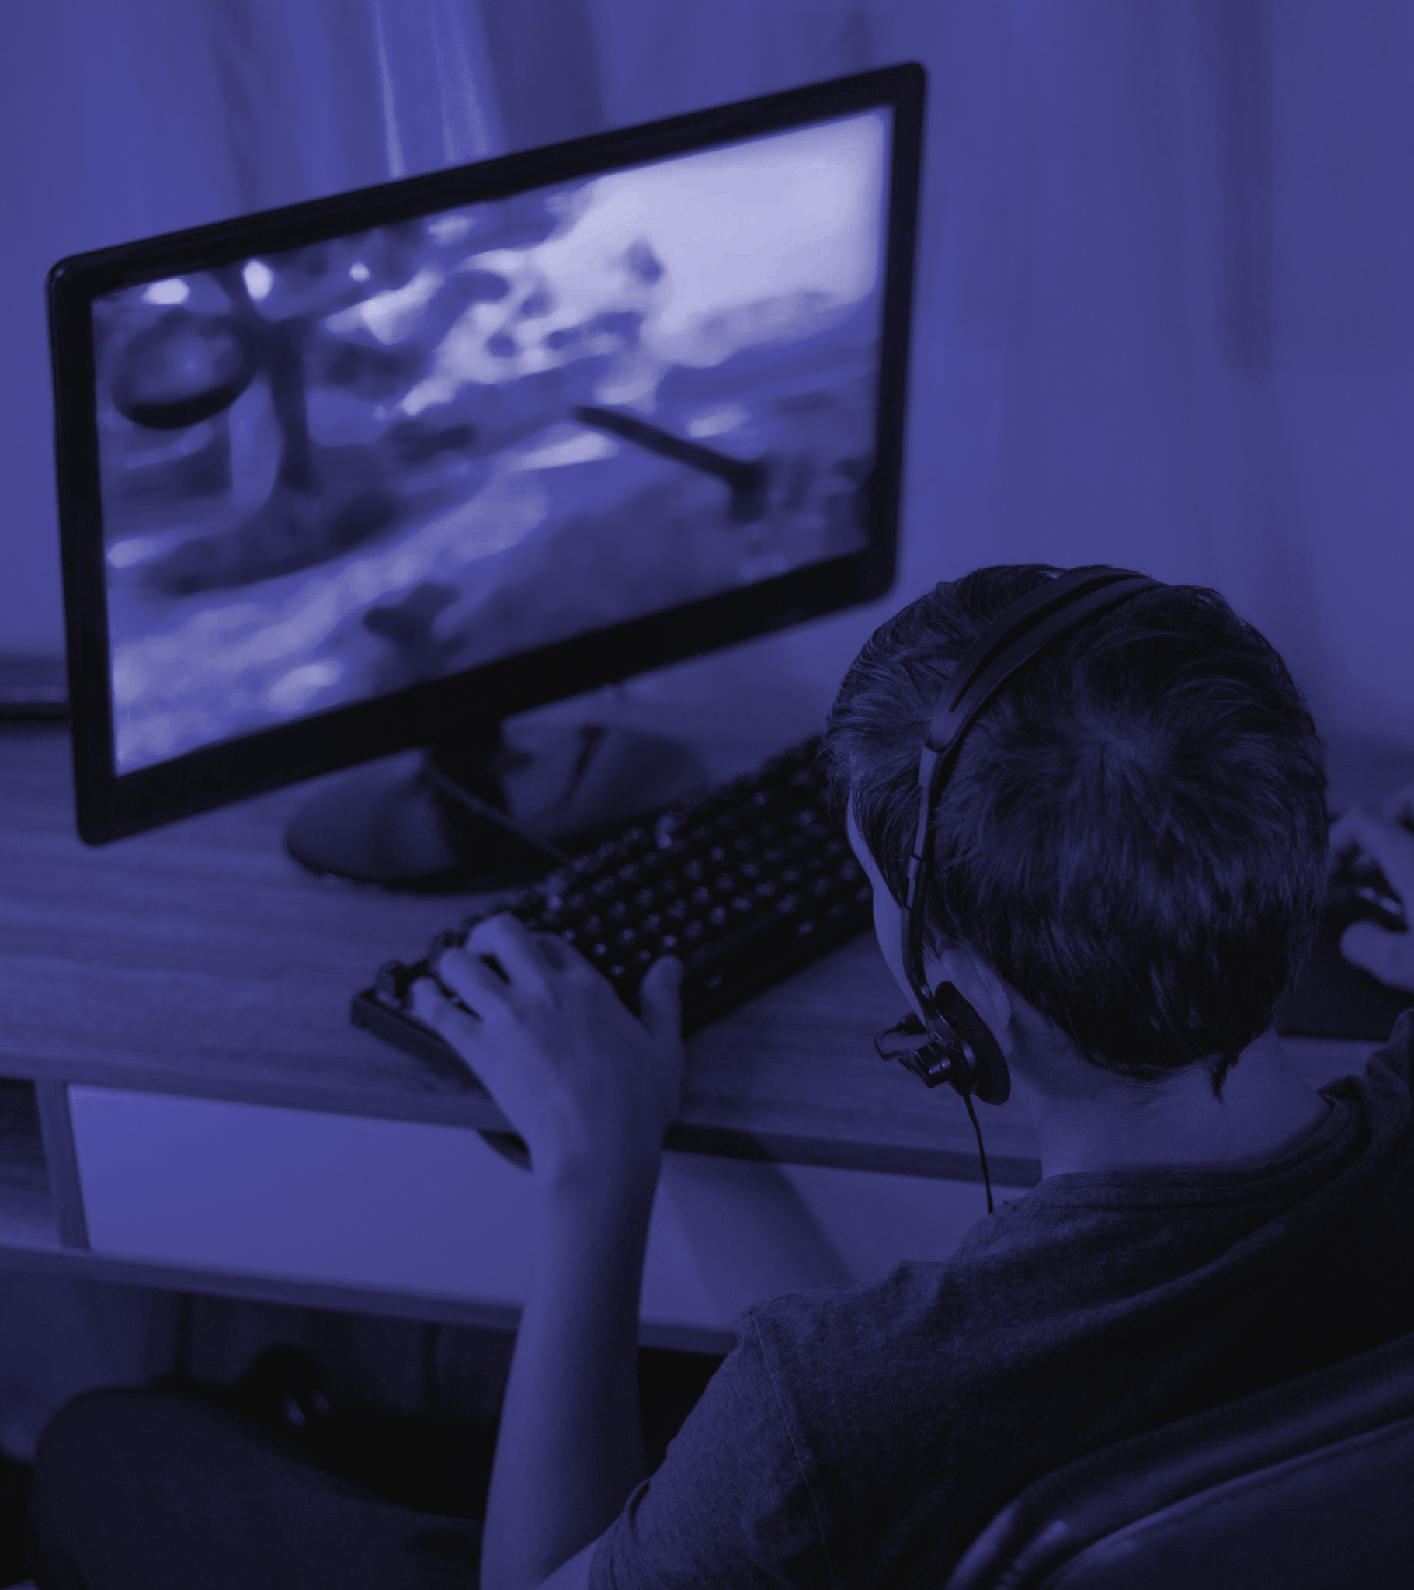
GAME LOGIC

Slide 14
Create the Screen
Create the Snake
Moving the Snake
Adding the Food
Increasing the Length of the Snake
Game Over when Snake hits the boundaries
Displaying the Score

Slide 15
CONCLUSION

Slide 16
Accessible to every age group
Addictive and Interesting
Gives basic Ideas about gaming from a young age.
No specific software and hardware are required.
Easy to play with simple controls.
Gaming helps improve IQ and Concentration.

Slide 17
REFERENCES

Slide 18
1. https://www.edureka.co/blog/snake-game-with-pygame/
2. https://www.youtube.com/@CodeWithHarry
3. https://melmagazine.com/en-us/story/snake-nokia-6110-oral-history-taneli-armanto
4. https://en.wikipedia.org/wiki/Snake_(video_game_genre)

Slide 19
Q & A Session

Slide 20
Thanks!
PRANGYA PARIMEETA DEHURY ( BS20 – 253 )

